Slide 1

Monthly Meeting
Aug 2024

Slide 2
Agenda
Background Knowledge
Exploration of LiDAR enhanced CL Control of Helix
To do (Roadmap)

Slide 3
LiDAR-Enhanced Closed Loop Wake Mixing Control
Aug 2024

Slide 4
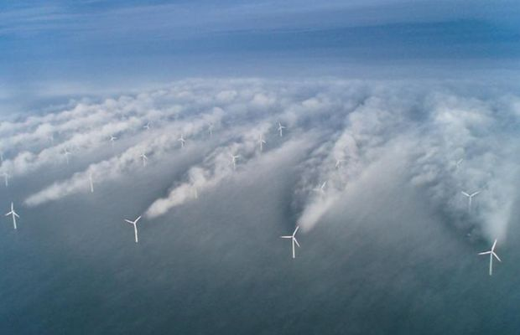
Wake Effect
Effect on downstream WT:
Less power production
Increase structural loads
20 – 45% Loss of Energy
Notes:
The downstream turbine encounters a significantly reduced free-stream velocity compared to the upstream turbine, leading to less energy being available in the flow.

Slide 5
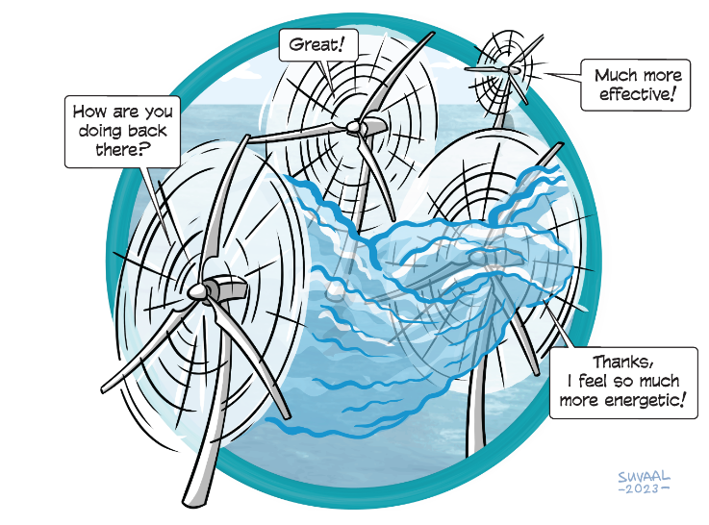
Wind Farm Flow Control
Axial Induction Control
Wake Steering
Wake Mixing

Slide 6
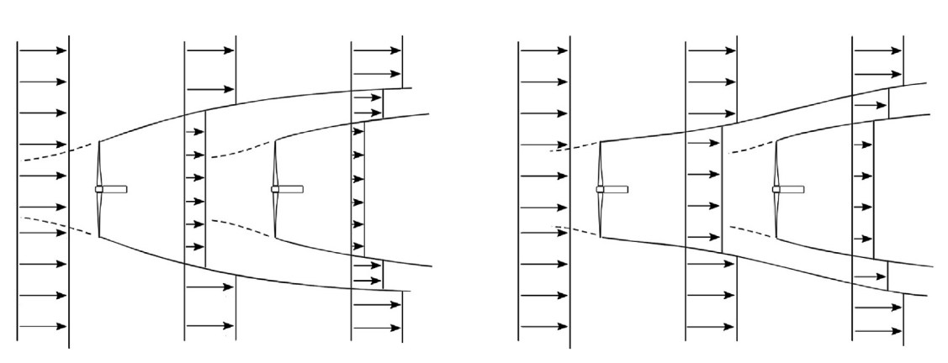
Axial Induction Control
Derate
the potential for increased energy extraction is rather low
Normal Operation
Axial Induction Control
Notes:
Delibrately operate the upstream turbine below the maximum condition to save more energy to the downstream turbine

Slide 7
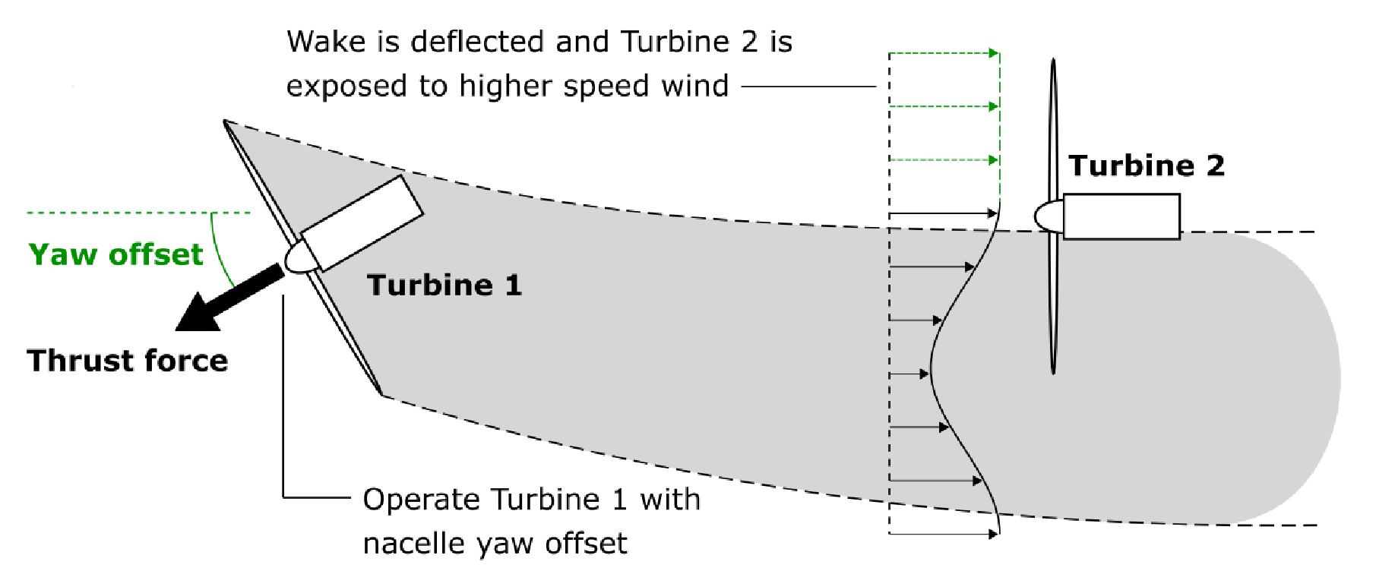
Wake Steering
Notes:
Decrease the overlap between the upstream turbine’s wake and the downstream turbine’s air by a yaw offset.
Advanced for commercial usage
Challenges remain in this area mostly related to the complex response of the wake to yaw set-points and its strong dependence on atmospheric conditions.

Slide 8
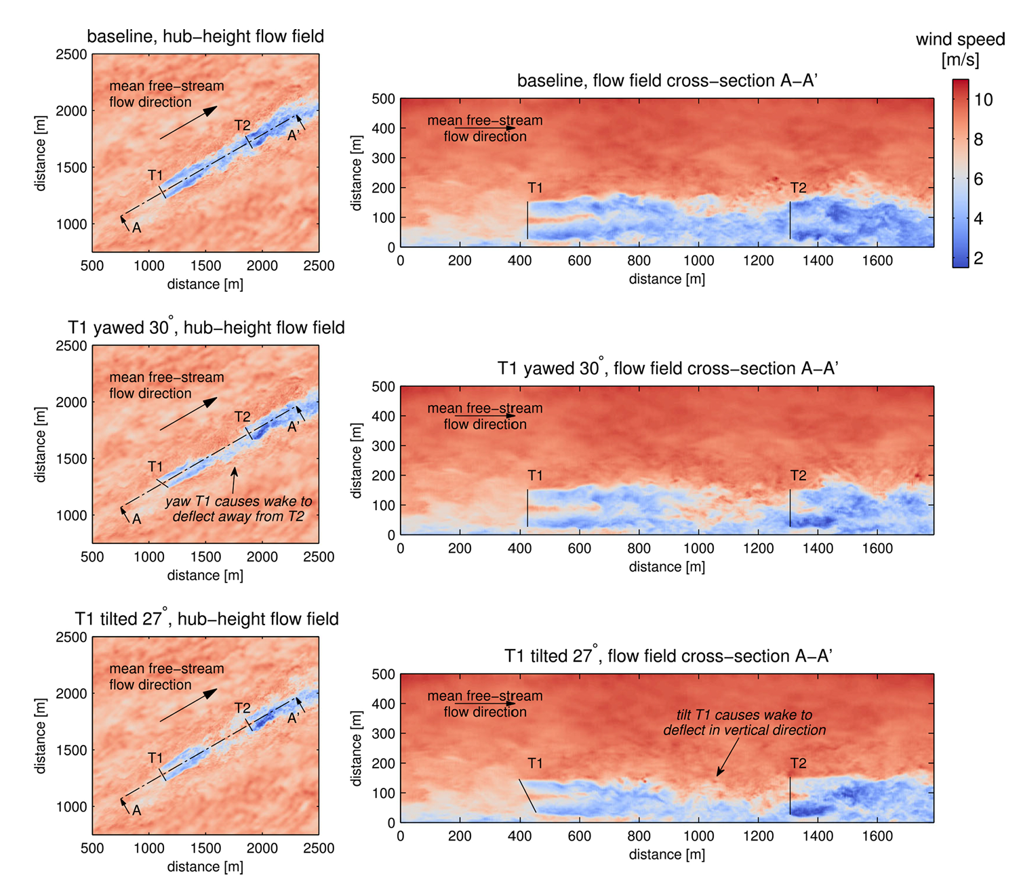
Notes:
Decrease the overlap between the upstream turbine’s wake and the downstream turbine’s air

Slide 9
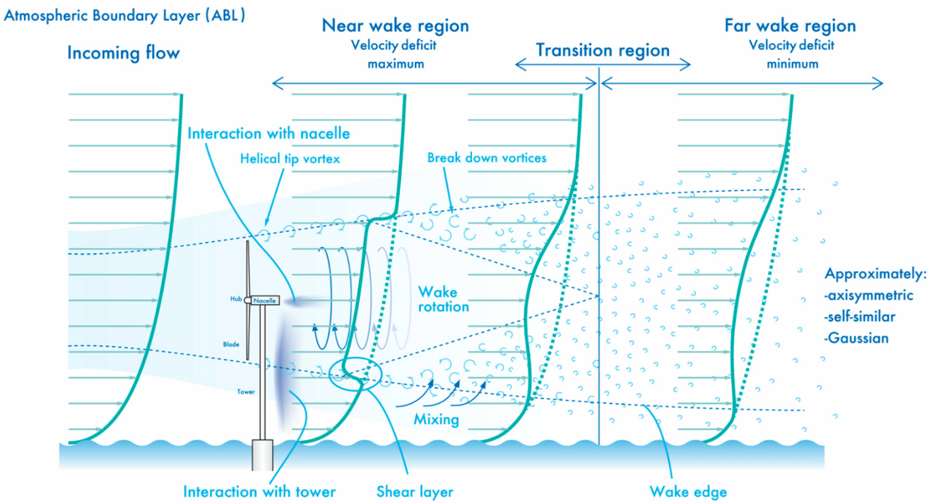
Wake Mixing
Notes:
This slide shows how the wake evolves with increasing distance from the turbine.
Wake recovers by mixing with the free-ambient air. Thus, if we can facilitate this mixing, there will be a faster recovery of wake, and thus, increase the power generation of the downstream turbine.
So let’s delve a bit deeper into how the wake is mixed.

Slide 10
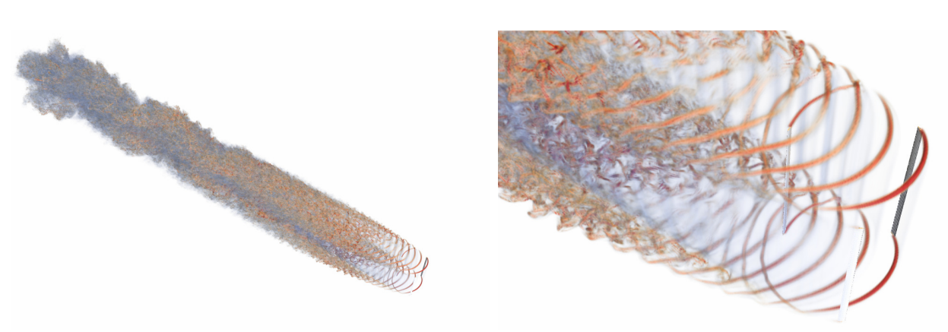
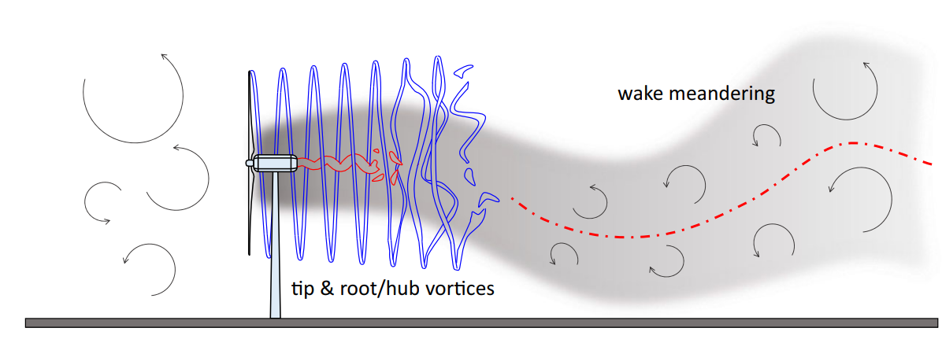
Wake Mixing
Notes:
Two mechanisms:
Tip & Root Vortex breakup
Wake Meandering
These two facilitate the mixing of wake with the ambient air. Hence, the wake mixing technique aims to facilitate those two things deliberately

Slide 11
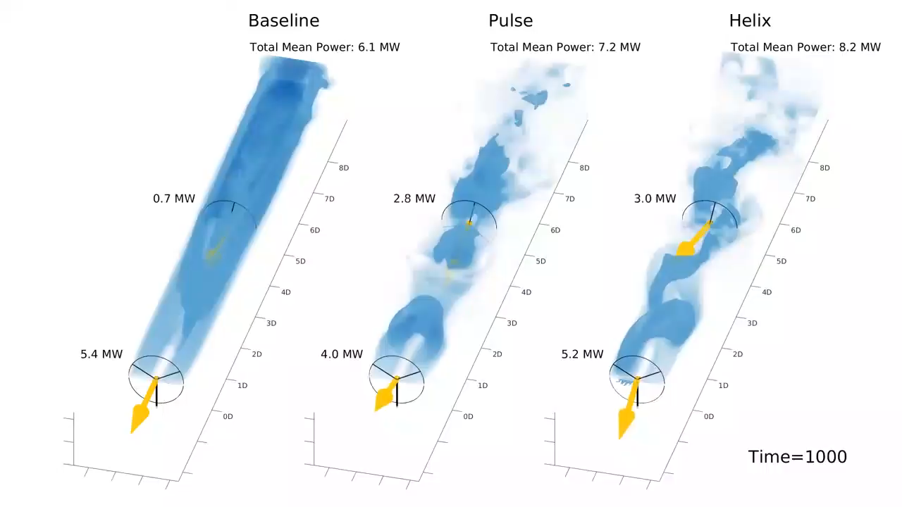
Wake Mixing
Facilitate mixing of free-ambient air and wake for wake recovery
Notes:
The arrow stands for the thrust force

Slide 12
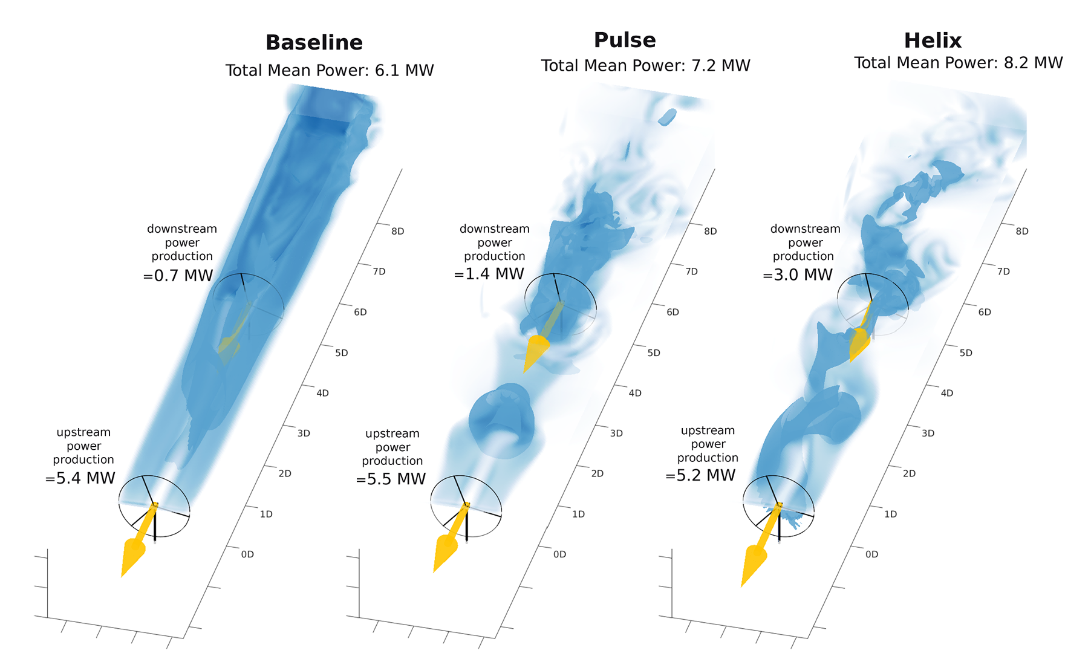
Wake Mixing
Facilitate mixing of free-ambient air and wake for wake recovery
Notes:
The wake mixing control strategy is developed to enhance the mixing of the turbine’s wake with ambient free-stream velocity air. This enhanced mixing accelerates the energy recovery of the wake more effectively than would occur through natural wake processes and recovery mechanisms.
Pulse: varying thrust coefficient sinusoidal ----> Load ----> More consistent
Helix: Individual Pitch Control

Slide 13
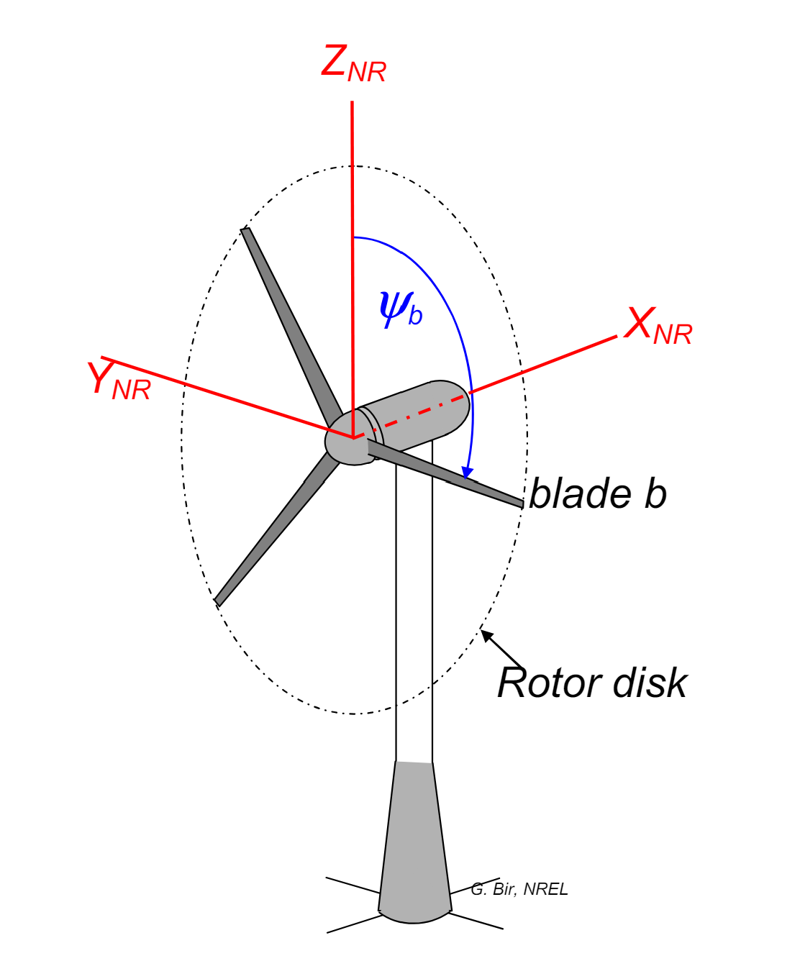
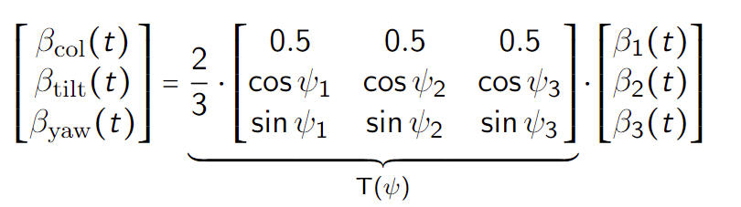
Helix --- MBC Transform
Rotating Frame → Non-rotating Frame
Notes:
MBC transform map the signals from rotating frame to the non-rotating one.
In this fixed frame, the individual pitch commands can be computed as decoupled collective, tilt, and yaw pitch commands respectively, allowing simple SISO control loops instead of MIMO

Slide 14
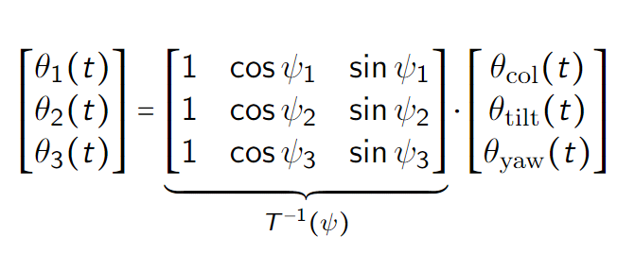
Helix --- Inverse MBC Transform
Non-rotating Frame → Rotating Frame
Notes:
By using the inverse MBC, we just need to give the tilt and yaw moment, then the blade pitch signals are acquired.

Slide 15
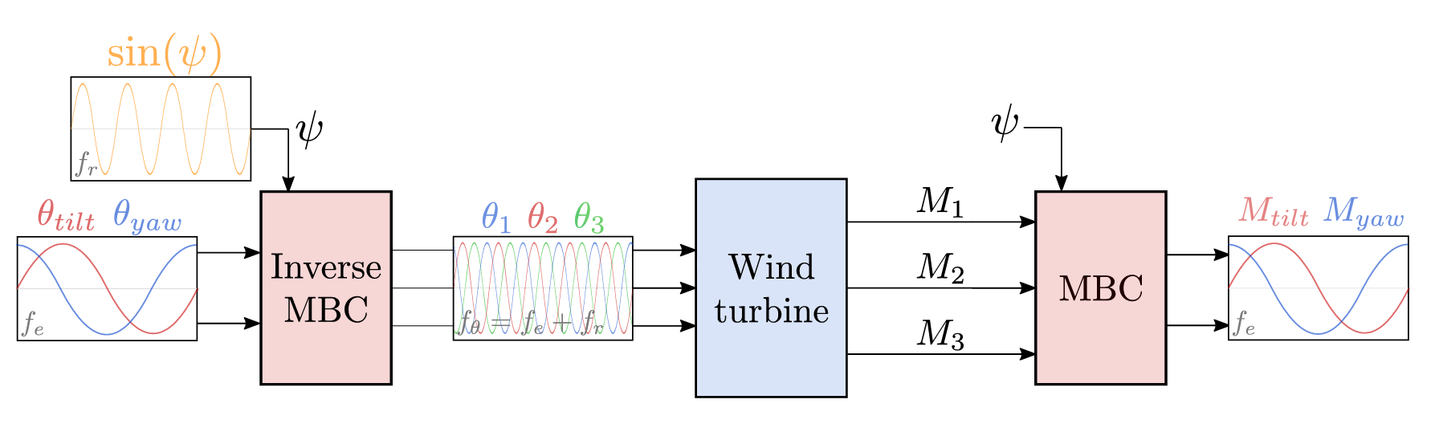
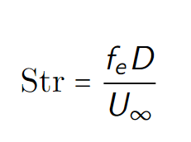
Helix --- Block Diagram
Sinusoidal signals
Frequency
Amplitude
Phase
Notes:
Beta(tilt) and Beta(yaw) for rotor disk, based on the phase different of tilt and yaw, the helix is clockwise or counterclockwise

Slide 16
Gap of the Helix
Open-Loop Control:
No feedback from output
Can we closed-loop control the helix approach based on flow information?
Notes:
Disturbance Rejection
Accuracy and Precision
Input-based control vs. Output-based control: Directly monitors and adjusts the system outputs.

Slide 17
Research Question
How to closed-loop control the helix approach?
Handle model error, uncertainties
Real-time Control
Notes:
The main question, answer WHY you want to do all the stuff?

Slide 18
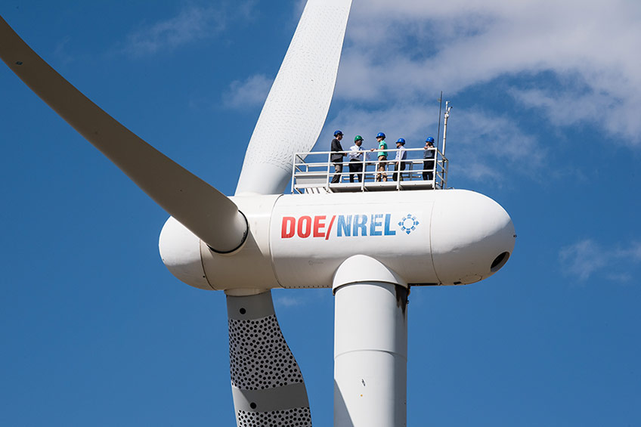
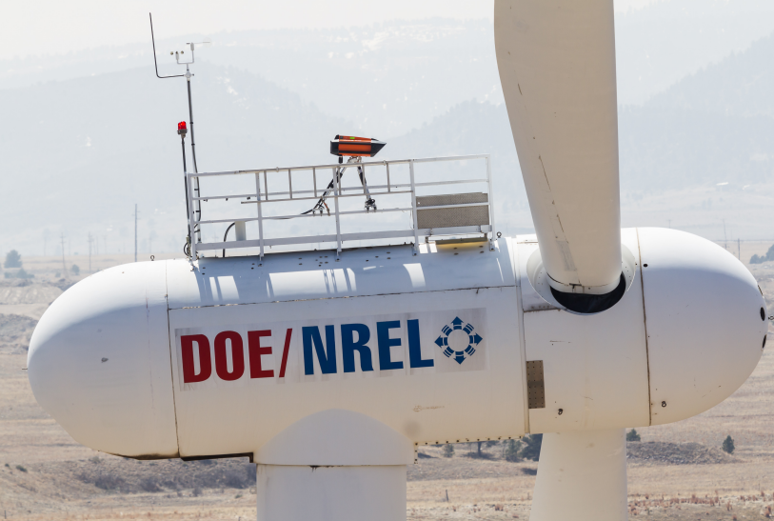
Feedback --- LiDAR
Notes:
To close the loop, one of the most important things is to get the feedback --- LiDAR

Slide 19
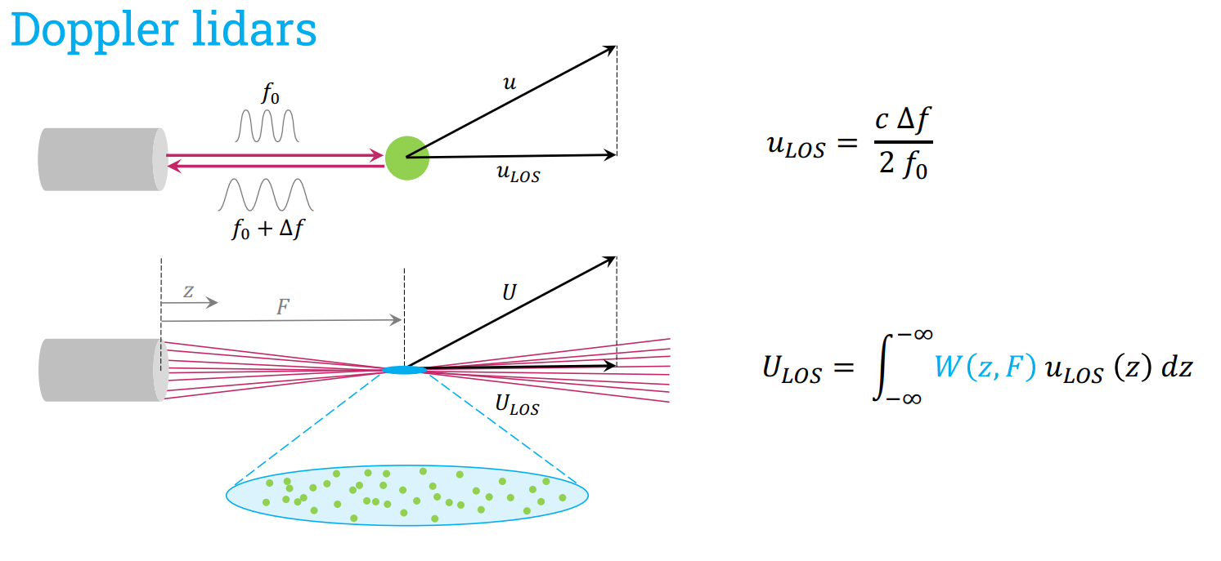

Slide 20
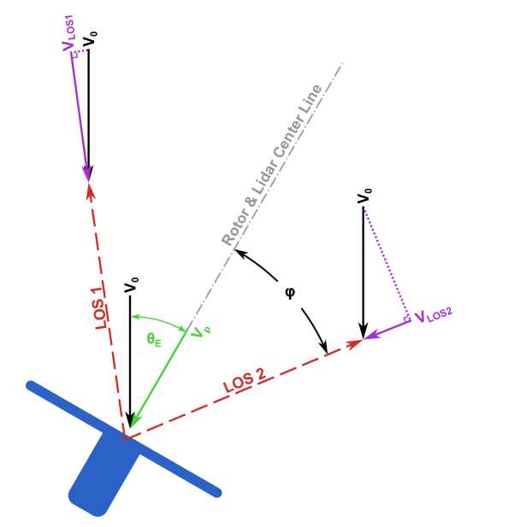
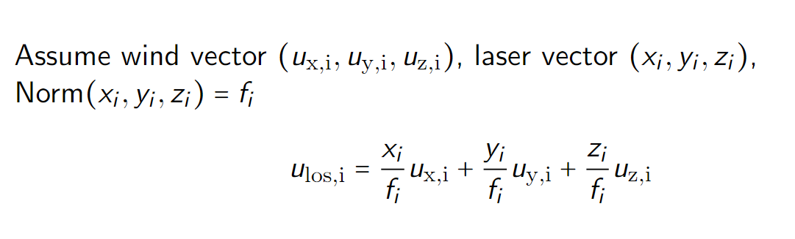
LiDAR Model
Notes:
LiDAR is placed in the perfect location --- 1.86D for IEA15MW so that the diameter of the ring is the same as D

Slide 21
Research Question
How to integrate LiDAR and the helix approach for closed-loop wake mixing control for wind farms?
Which LiDAR configuration to use?
What feature in the helix wake should be controlled, and how to obtain it using LiDAR?
How to design the control loop to rectify the helix?
Potential for next step?

Slide 22
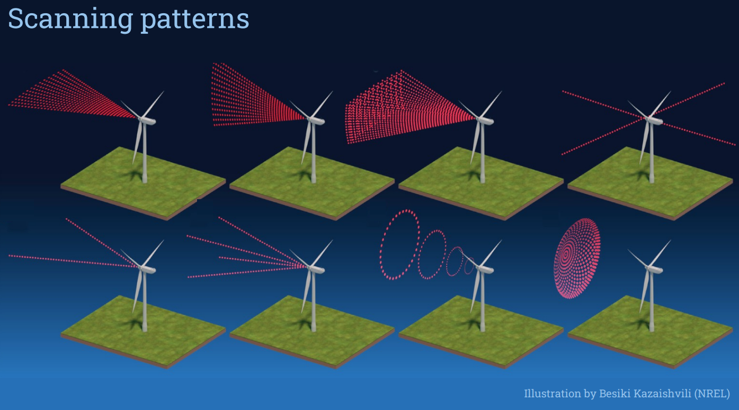

Slide 23
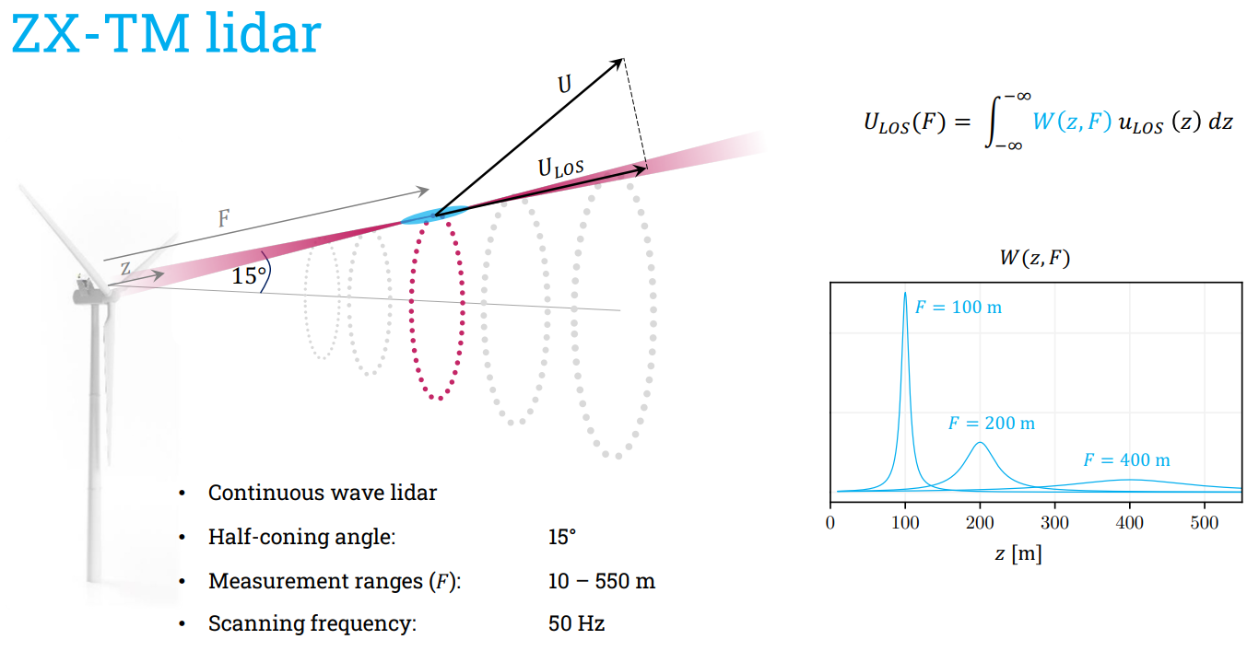

Slide 24
LiDAR Choosing
Trade off between practicality and quality --- Modified ZX-TM LiDAR
Continuous Wave LiDAR (one focal distance)
10 – 720 m
Half-cone angle: -
Entire rotor disk

Slide 25
Research Question
How to integrate LiDAR and the helix approach for closed-loop wake mixing control for wind farms?
Which LiDAR configuration to use? √
What feature in the helix wake should be controlled, and how to obtain it using LiDAR?
How to design the control loop to rectify the helix?
Potential for next step?
Notes:
So here, we answered the first question, what configuration of LiDAR to be used.

Slide 26
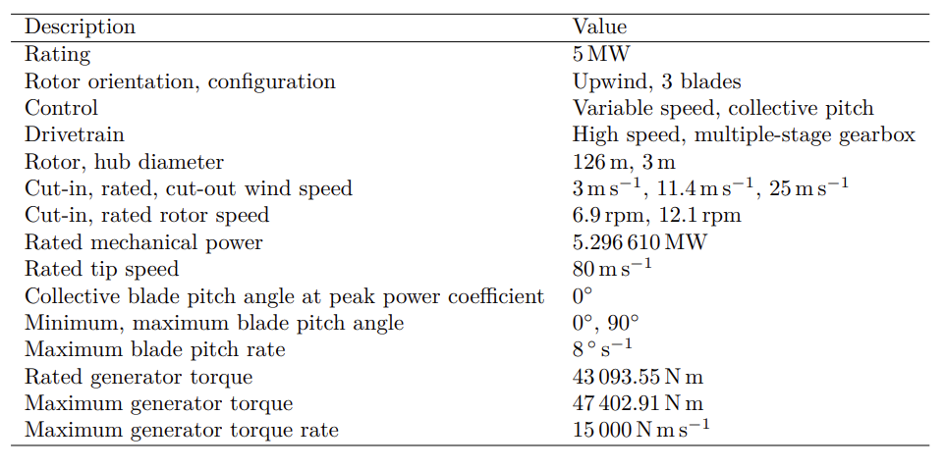


Practical Tool
Notes:
Q-blade
MATLAB
NREL5MW

Slide 27
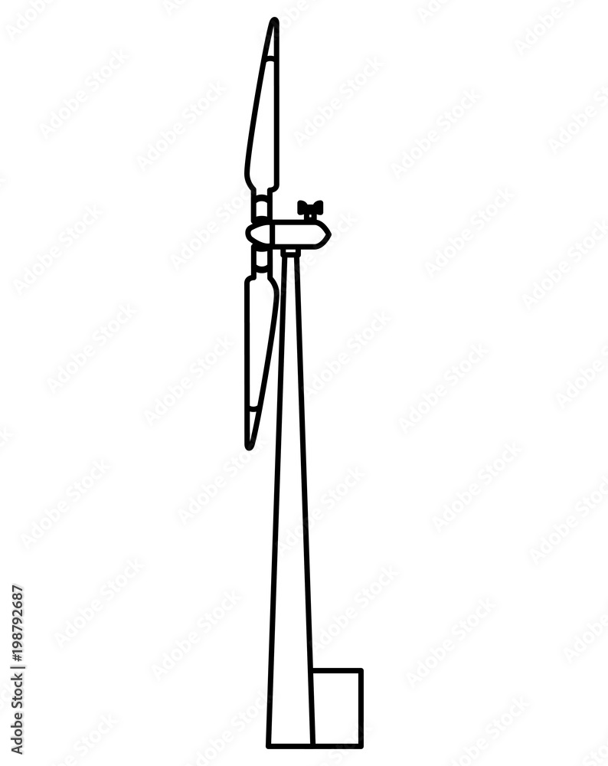
Simulation Setup
1D
1D
Notes:
Downwind facing LIDAR
Measuring 1D (rotor disk) position

Slide 28
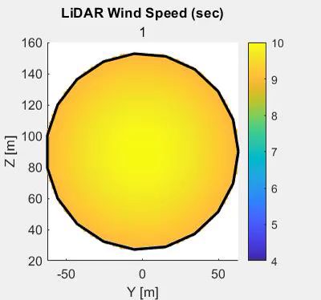
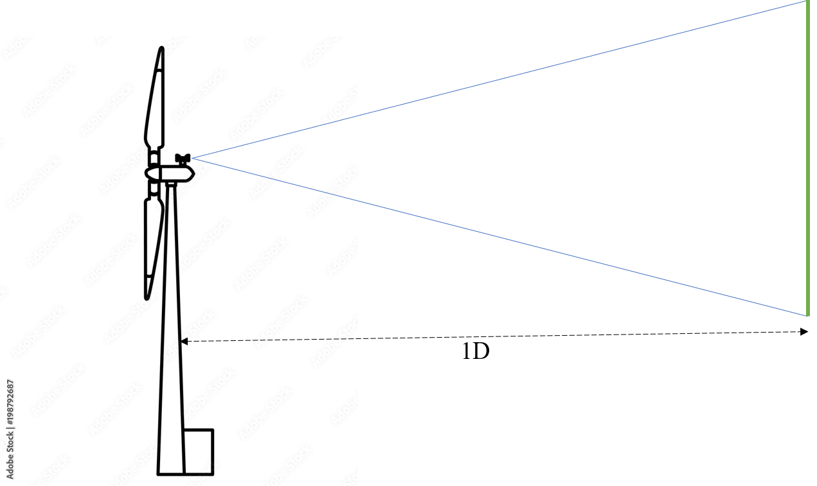
Demo of LiDAR
U = 10 m/s
CCW
Str = 0.3
Amplitude = 3
Notes:
Q-blade doesn’t have any LiDAR functionality, so I spent around a week time to implement the LiDAR functionality and optimize it so that it’s fast enough (2 days --> 10 mins --> 2 mins )
Wake center is what I am aiming at
1. obvious
2. accessible in real-time

Slide 29
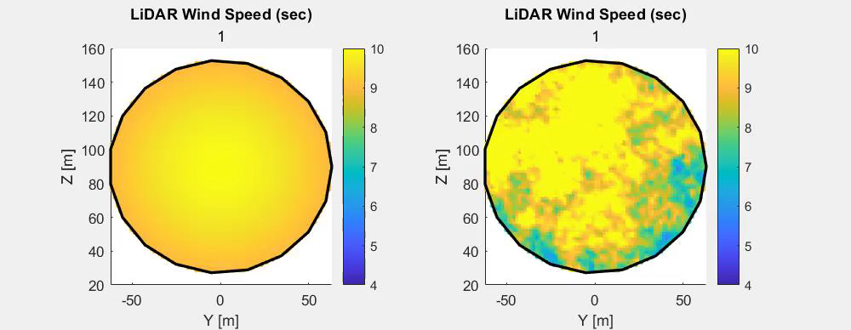
Why closed-loop control?
Notes:
With LiDAR, we are able to visualize the helix downwind, and based on some play arounds, we can answer the question of what to control

Slide 30
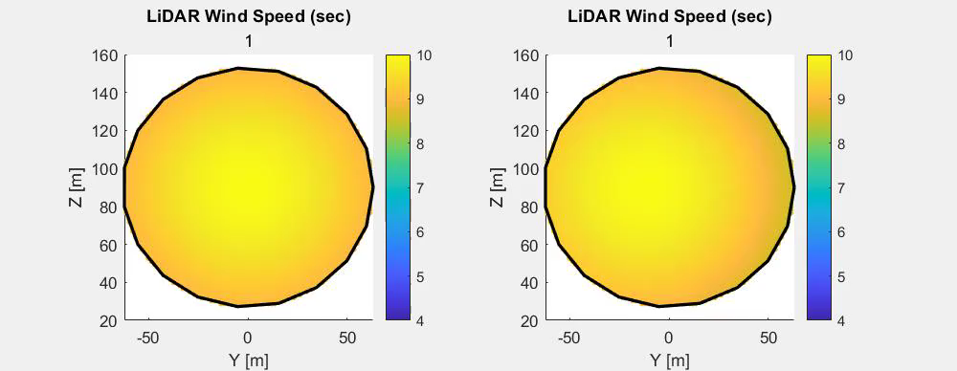
Why closed-loop control?
Notes:
With LiDAR, we are able to visualize the helix downwind, and based on some play arounds, we can answer the question of what to control

Slide 31
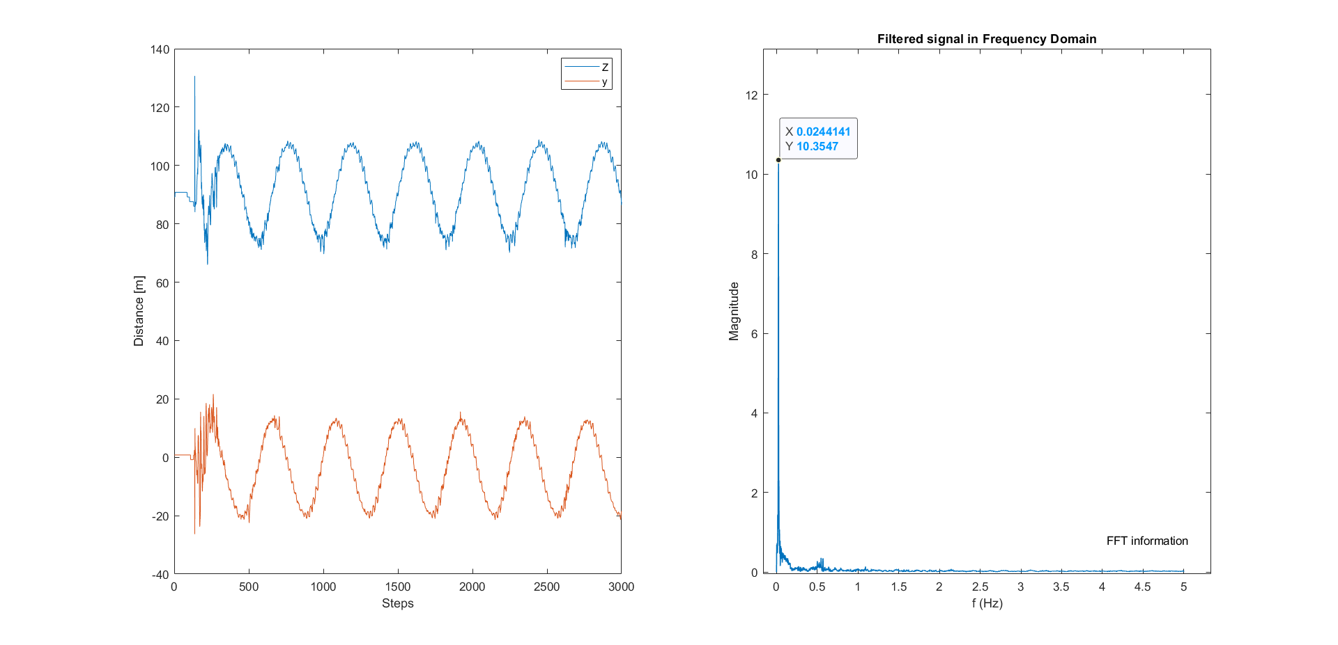
What to control?
Notes:
CCW, coordinate of helix center, two periodic signal

Slide 32
MBC Transform
Rotating Frame → Non-Rotating Frame
1P, 1P+fe → 0P, fe

Slide 33
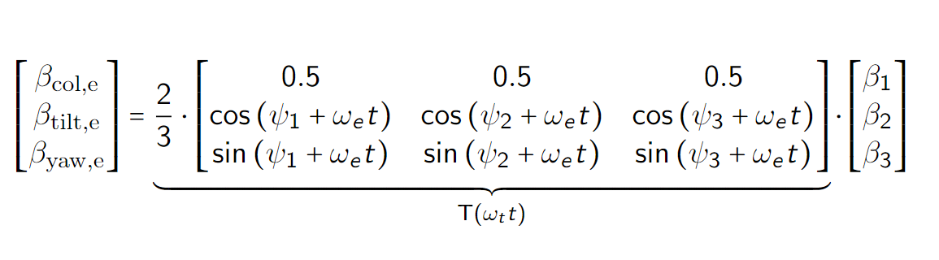
New Transform
Non-Rotating Frame → Helix Frame
1P, 1P+fe → 0P, fe
1P, 1P+fe → 0P, fe → 1P, 0P

Slide 34
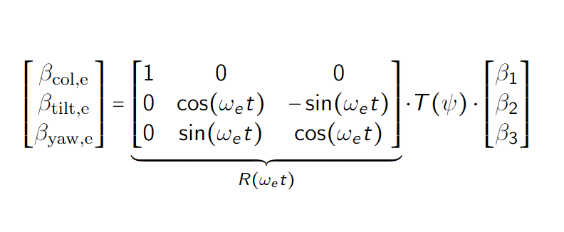
New Transform
Non-Rotating Frame → Helix Frame
1P, 1P+fe → 0P, fe
1P, 1P+fe → 0P, fe → 1P, 0P

Slide 35
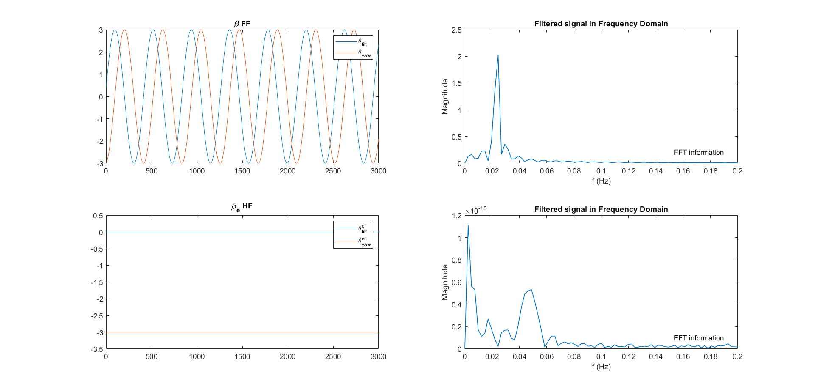
New Transform

Slide 36
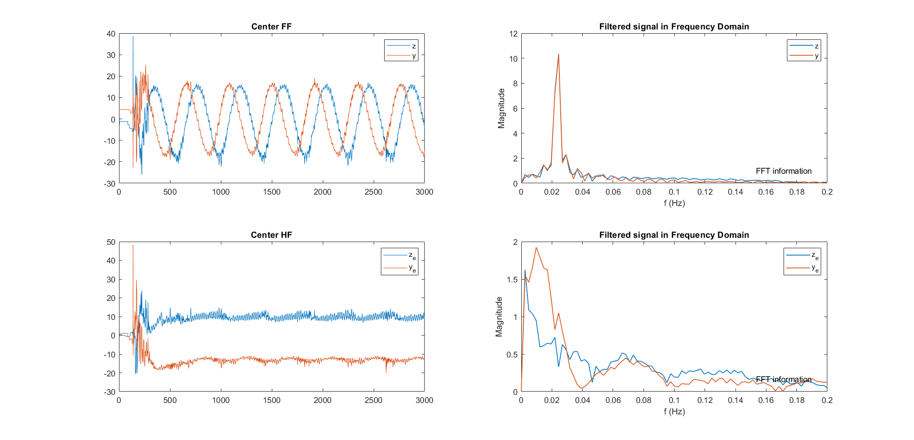
New Transform

Slide 37
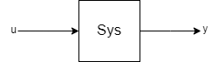
Control Relation Exploration
Principle of Control:
As simple as possible (Static)

Slide 38
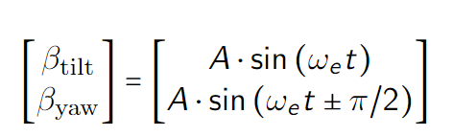
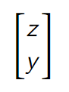
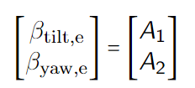
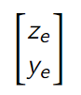
What to control?
Fixed Frame
FF theta
FF center
Helix Frame
HF theta
HF center
Notes:
There are four different combination that can be controlled
We explore the relation between input and output by first open-loop control the whole system

Slide 39
What to control?
Fixed Frame
FF theta
FF center
Helix Frame
HF theta
HF center
Notes:
Principle: Simplified as much as possible, so static it is

Slide 40
What to control?
Fixed Frame
FF theta
FF center
Helix Frame
HF theta
HF center
Notes:
There are four different combination that can be controlled
We explore the relation between input and output by first open-loop control the whole system

Slide 41
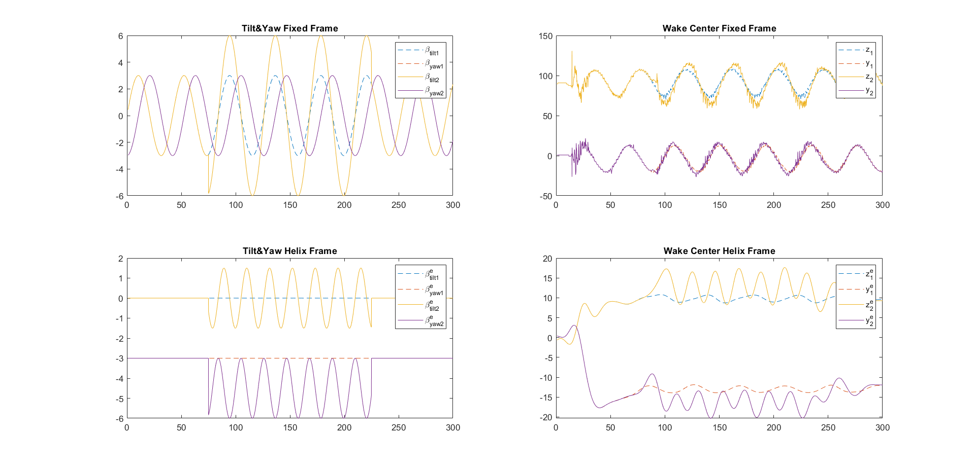
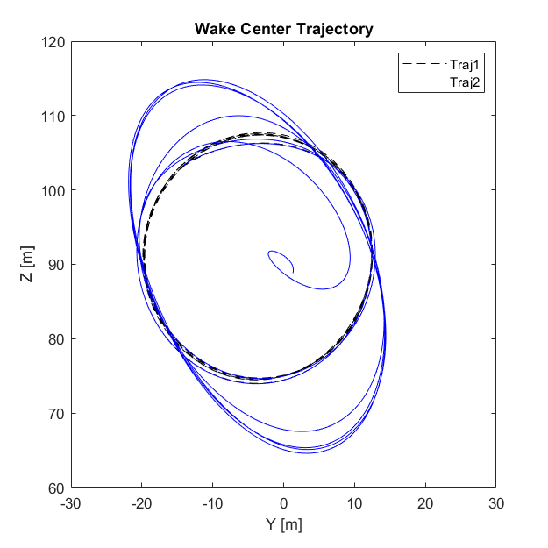
FF theta – FF center (Amplitude)
Notes:
First the magnitude of beta tilt and beta yaw

Slide 42
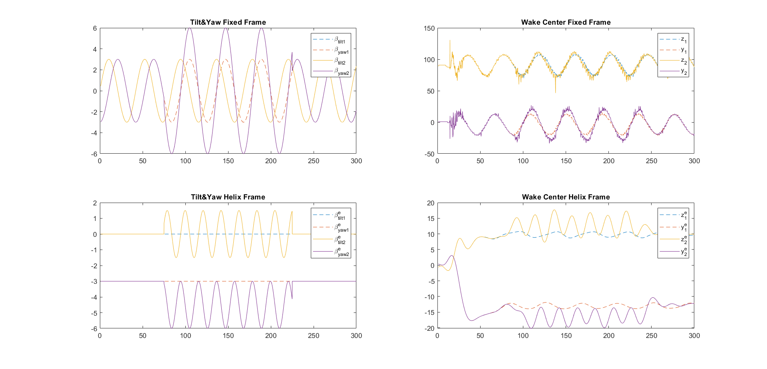
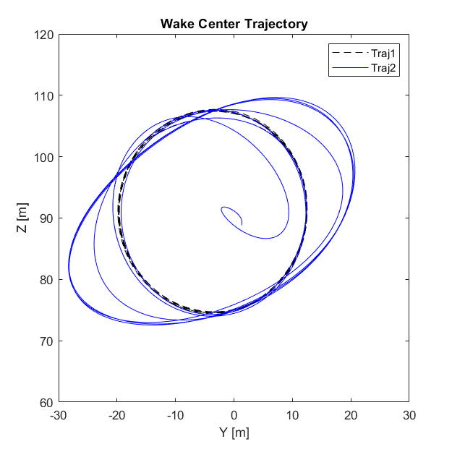
FF theta – FF center (Amplitude)

Slide 43
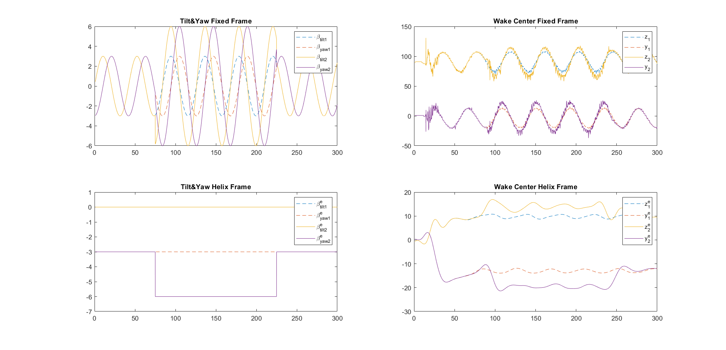
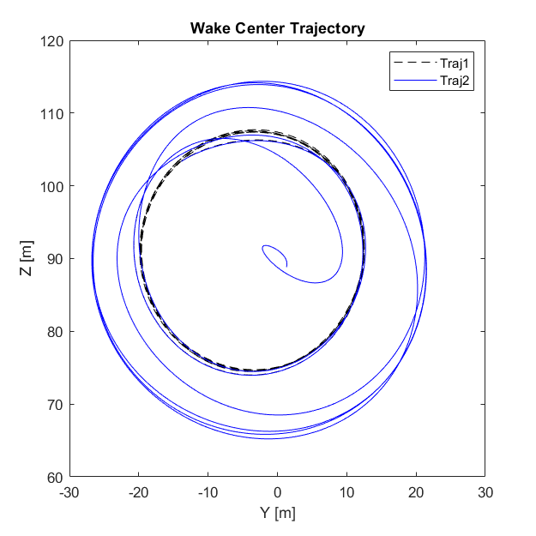
FF theta – FF center (Amplitude)

Slide 44
FF theta – FF center Analysis
Changing magnitude changes rotating magnitude of one degree of freedom
Tilt and Yaw are decoupled and orthogonal
But the rotating nature makes it hard to control

Slide 45
Center of Center
Notes:
With LiDAR, we are able to visualize the helix downwind, and based on some play arounds, we can answer the question of what to control

Slide 46
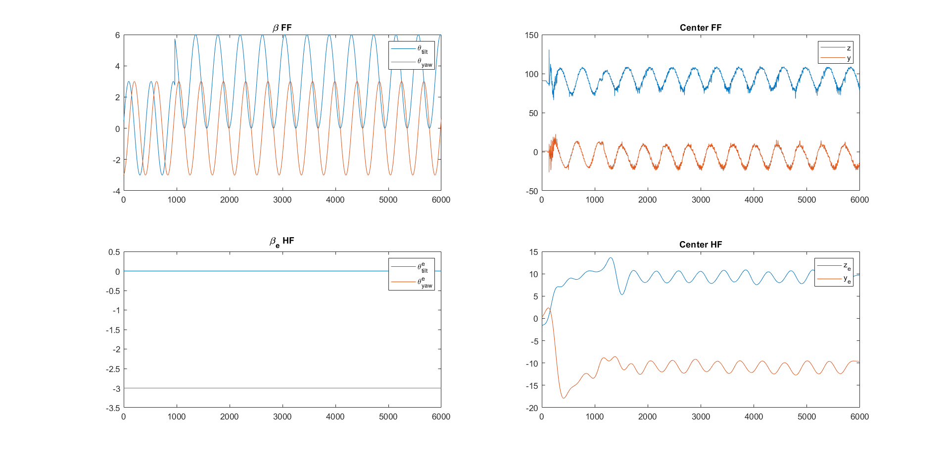
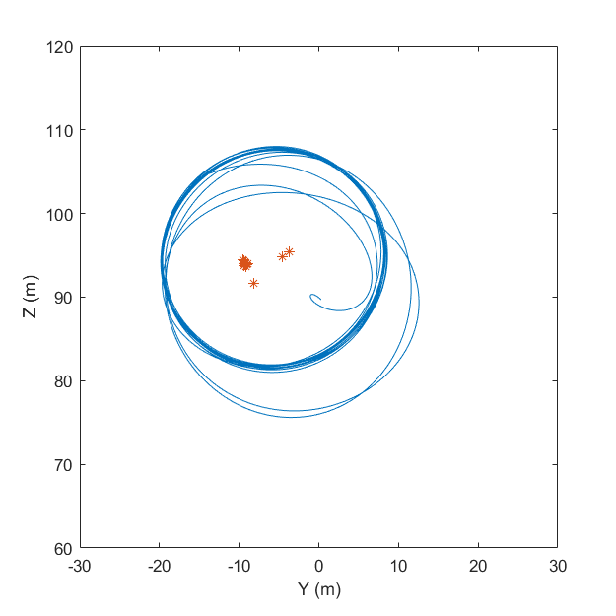
FF theta – FF center (Bias)
Notes:
And then the bias

Slide 47
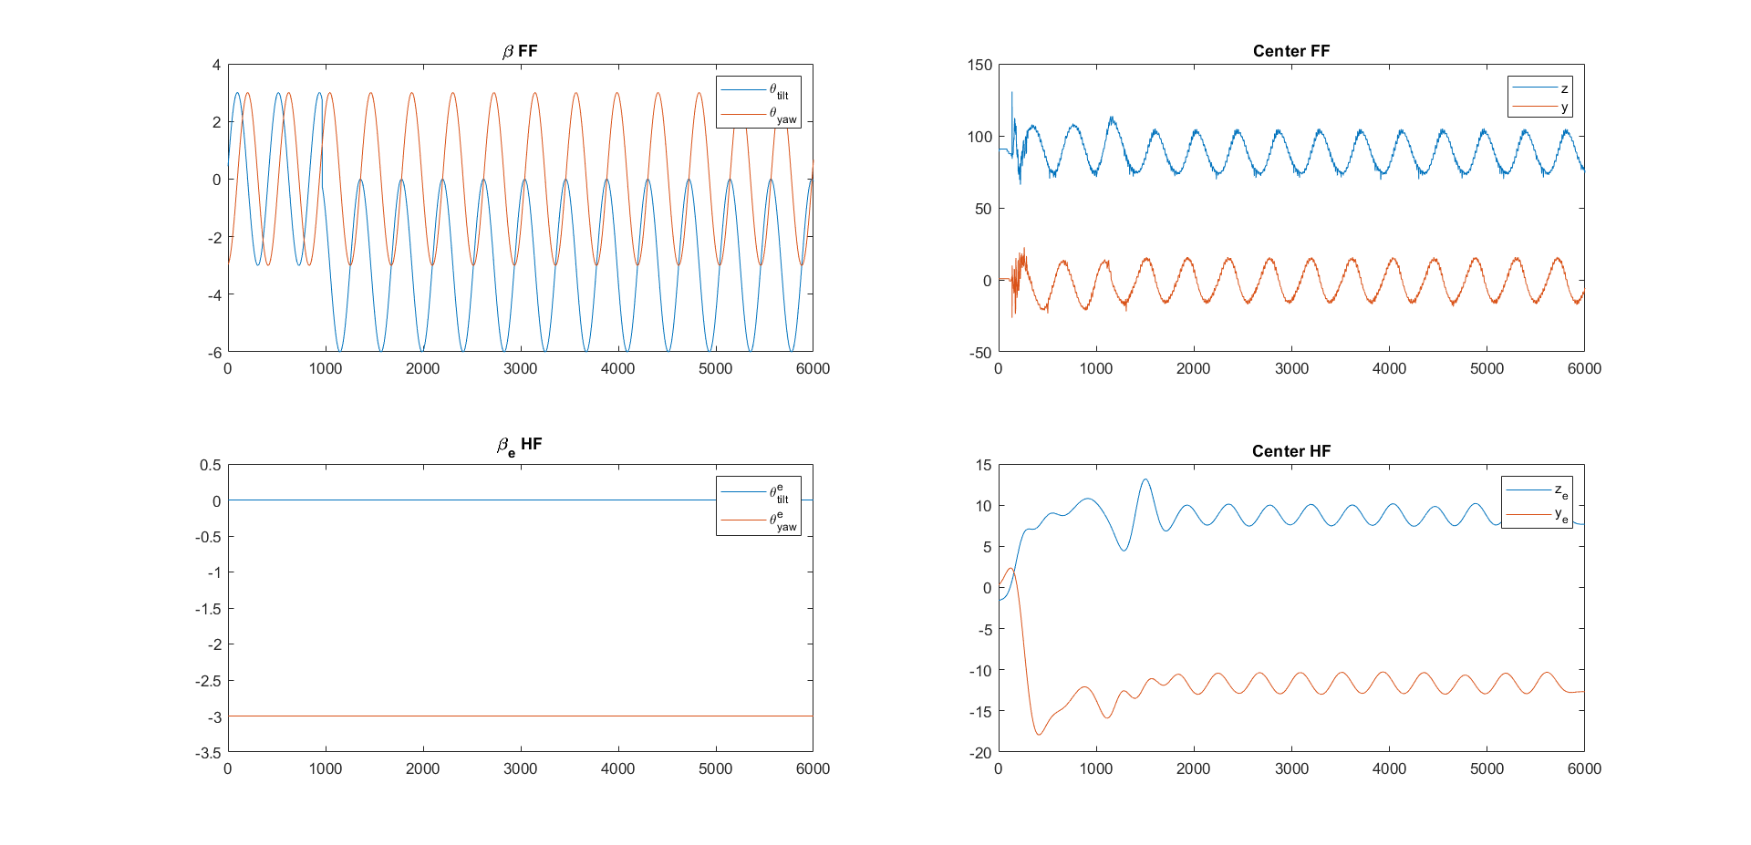
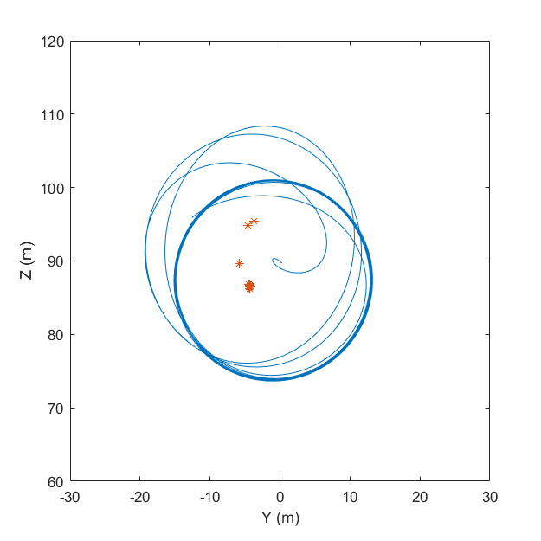
FF theta – FF center (Bias)
Notes:
And then the bias

Slide 48
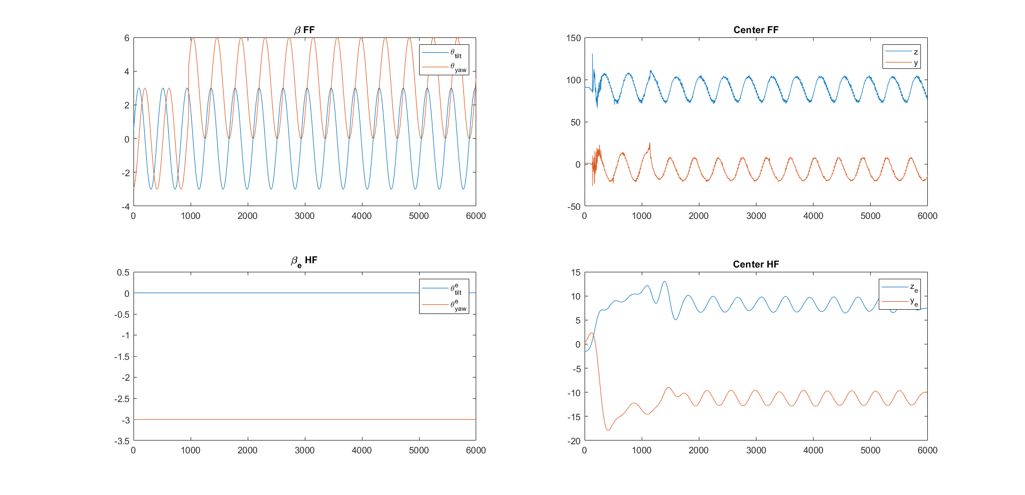
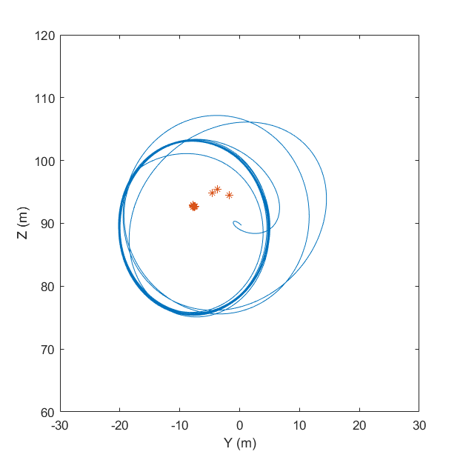
FF theta – FF center (Bias)
Notes:
And then the bias

Slide 49


FF theta – FF center (Bias)
Notes:
And then the bias

Slide 50


FF theta – FF center (Bias)
Notes:
And then the bias

Slide 51

FF theta – FF center (Bias)
Notes:
And then the bias

Slide 52

FF theta – FF center Analysis
Changing magnitude changes rotating magnitude of one degree of freedom
Tilt and Yaw are decoupled and orthogonal
But the rotating nature makes it hard to control
No free lunch when controlling the center of center

Slide 53
What to control?
Fixed Frame
FF theta
FF center
Helix Frame
HF theta
HF center
Notes:
There are four different combination that can be controlled

Slide 54
What to control?
Fixed Frame
FF theta
FF center
Helix Frame
HF theta
HF center
Notes:
There are four different combination that can be controlled
We explore the relation between input and output by first open-loop control the whole system

Slide 55


HF theta – HF center
Notes:
First the magnitude of beta tilt and beta yaw

Slide 56


HF theta – HF center
Notes:
First the magnitude of beta tilt and beta yaw

Slide 57


HF theta – HF center
Notes:
First the magnitude of beta tilt and beta yaw

Slide 58


HF theta – HF center
Notes:
First the magnitude of beta tilt and beta yaw

Slide 59


HF theta – HF center
Notes:
First the magnitude of beta tilt and beta yaw

Slide 60

HF theta – HF center Analysis
Coupling between the (z, y)
MIMO system
Phase and magnitude
Both variables are STATIC!

Slide 61
Research Question
How to integrate LiDAR and the helix approach for closed-loop wake mixing control for wind farms?
Which LiDAR configuration to use? √
What feature in the helix wake should be controlled, and how to obtain it using LiDAR? √
How to design the control loop to rectify the helix?
Potential for next step?
Notes:
So here, we answered the first question, what configuration of LiDAR to be used.

Slide 62

Control System Design
Notes:
Dead-time Delay

Slide 63


Dead-time Delay
Notes:
Dead-time Delay

Slide 64



Smith Predictor (CL Yaw Ctrl)
Notes:
Equations of internal model and delay.
The internal model predict the reaction of the wake to the demanded yaw angle. The first equation is the relationship of yaw, and then the second one is for the wake.

Slide 65


Model-based Control

Slide 66
Next Step
System IDE (U = 10m/s)
Model-based Controller Tuning
Next step depends on result of 2

Slide 67
Thanks for listening :)

